Slide 1
Adding value: we are more than just language teachers
Judy Copage

Slide 2
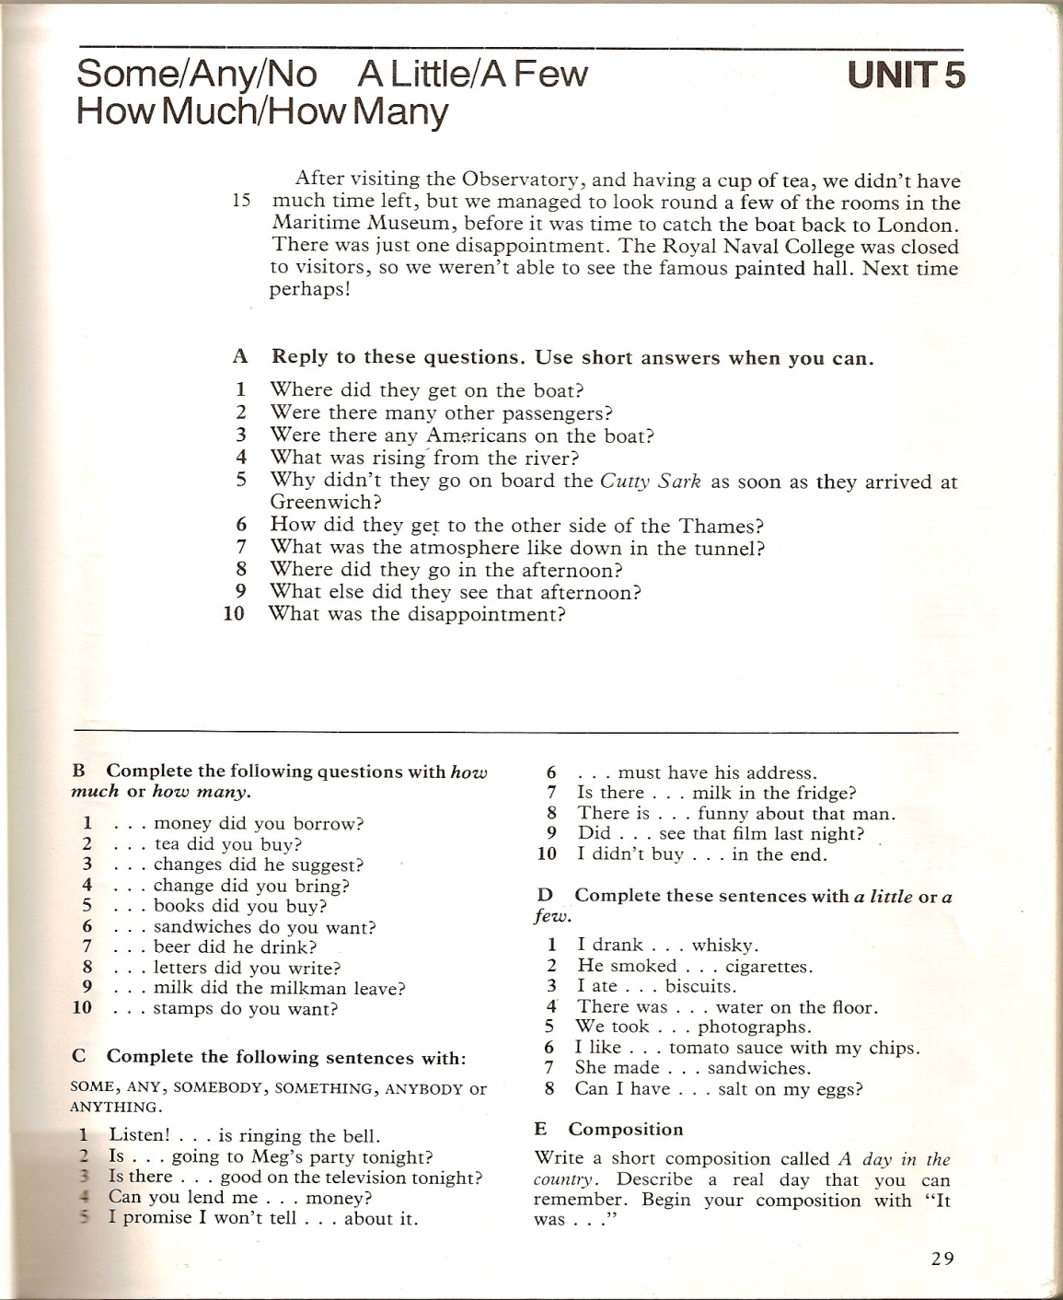
In the past …
Thorn, M. (1979) Exploring English. London: Cassells

Slide 3
Simple grammatical syllabus
And now?

Slide 4
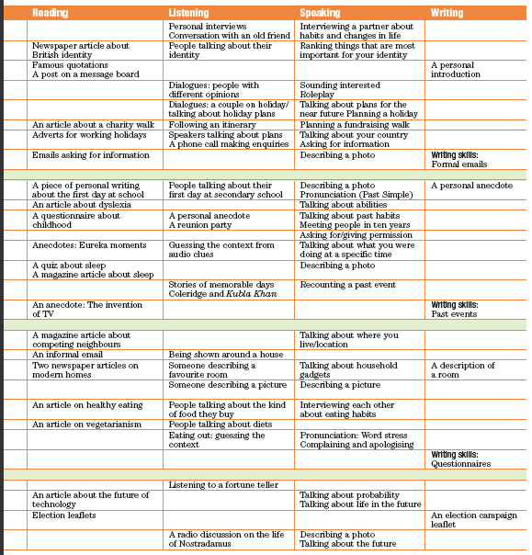
Changing views of both LEARNING and LANGUAGE

Slide 5
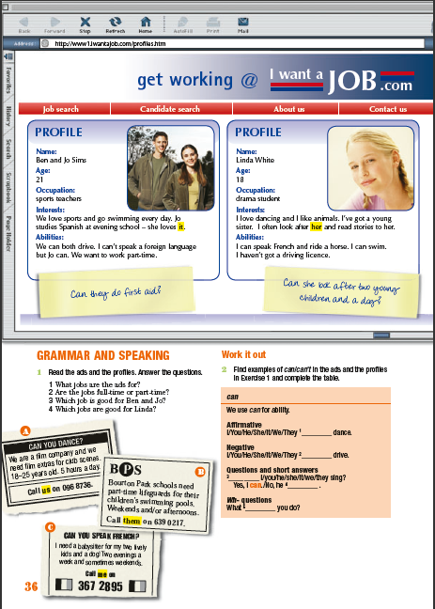
Colourful, well designed, varied input

Slide 6
What is expected of language teachers today?
Deliver the language syllabus … AND
Develop world knowledge
Develop intercultural awareness
Develop citizenship
Develop moral and psychological development
Develop cognitive skills
Prepare students for work/college

Slide 7
Why bother?
“… students will demonstrate their competency in such basic subjects as English, mathematics, science, history, and geography. In addition, students will acquire the thinking skills that will allow them to become responsible citizens, independent learners, and productive workers.”
“All adults will be sufficiently literate, knowledgeable, and skilled to compete in a global economy and behave as responsible citizens.”
University of Virginia 1989 Symposium on education (extract)

Slide 8
Precisely how are EFL teachers going to make students independent learners and responsible citizens?

Slide 9
World knowledge
Texts, dialogues and pictures contain information about the world
More formally, CLIL (Content and Language Integrated Learning) programmes link English to other curriculum subjects – work on language and content

Slide 10
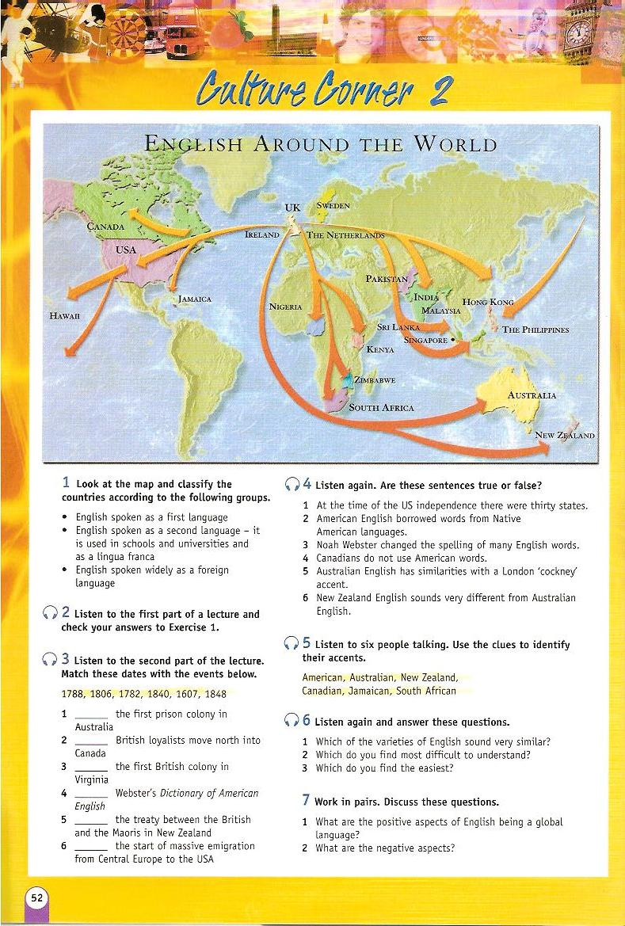
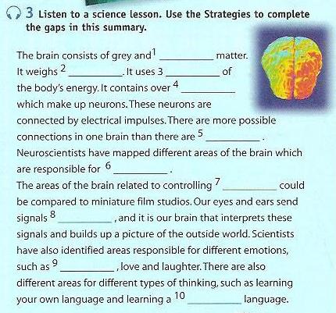

Slide 11
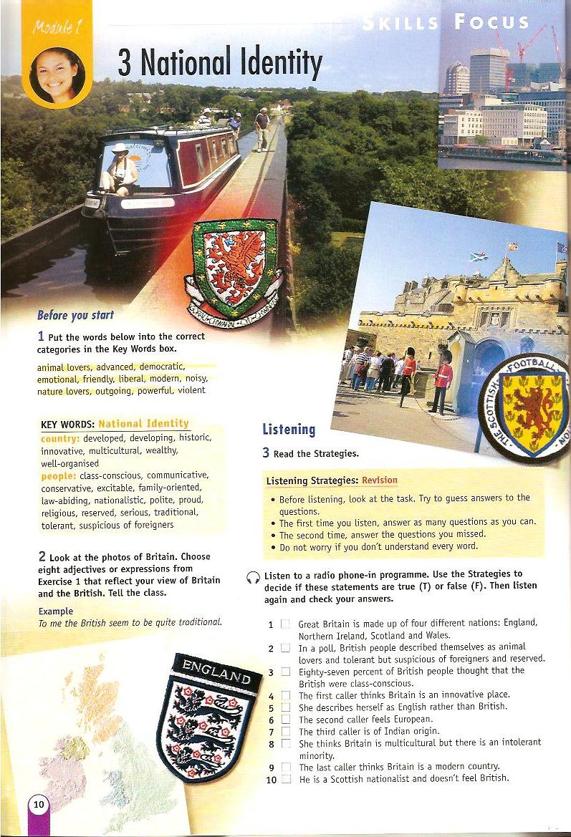
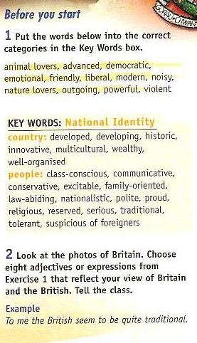
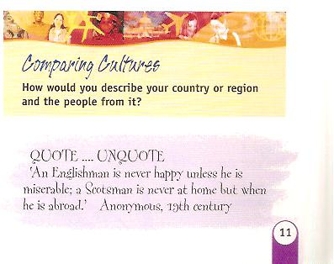
Inter-cultural awareness

Slide 12
Citizenship
Education for citizenship equips young people with the knowledge, skills and understanding to play an effective role in public life.
Citizenship encourages them to take an interest in topical and controversial issues and to engage in discussion and debate.
Pupils learn about:
their rights
responsibilities
duties and freedoms
laws, justice and democracy
http://curriculum.qca.org.uk/key-stages-3-and-4/subjects/key-stage-3/citizenship/index.aspx

Slide 13
They learn to take part in decision-making and different forms of action. They play an active role in the life of their schools, neighbourhoods, communities and wider society as active and global citizens.

Slide 14
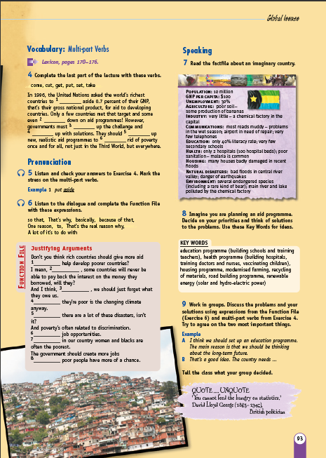

Slide 15
Moral and psychological development
“To love oneself is the beginning of a life-long romance.” Oscar Wilde
Build self-esteem
Awareness of others
Judgment and reasoning
Seeing both sides of an issue
Be an individual .... etc. etc. etc

Slide 16
You are a character educator. You are helping to shape the character of the students you come in contact with.
How do you educate for character?
the way you talk
the behaviours you model
the conduct you tolerate
the actions you encourage
the expectations you transmit
http://www.goodcharacter.com

Slide 17
“We need to engage our students in activities that make them think critically about moral and ethical questions and inspire them to become committed to moral and ethical actions.”
“Our aim should be to develop independent thinkers who are committed to moral principals in their lives, and who are likely to do the right thing even under challenging circumstances.”
http://www.goodcharacter.com

Slide 18
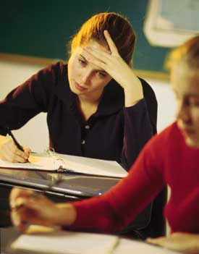
Ethical problem-solving
Georgia was fifteen minutes into her maths exam when she began to panic. This exam was worth most of her grade in the class. She understood maths - even liked it -and usually did really well. Her constant problem was that she wasn’t a strong test-taker. Her grades never reflected her understanding of the material she studied.

Slide 19
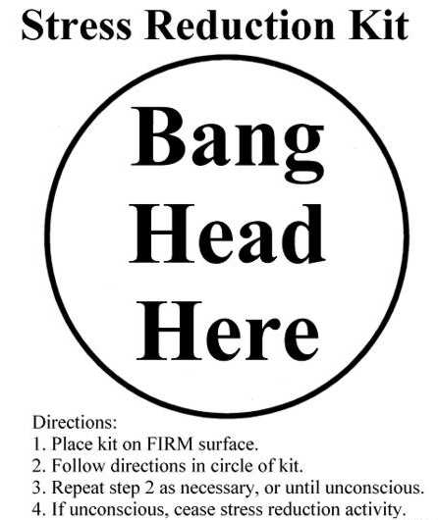
Now, she was stuck on one problem worth twenty-five points on the test. She put her head down on the desk and concentrated as hard as she could. She remembered doing a similar problem in class and explaining it to her friend Jessie, but now she was so stressed out by the test, she couldn’t even remember how to begin the problem. She imagined her parents’ looking at her report card.

Slide 20
Jessie was sitting right in front of her. He is always a good test taker and had already solved the problem. The teacher had his backed turned and was on the other side of the room. Georgia could look over Jessie’s shoulder, get the answer, and no one would know.
What should she do?

Slide 21
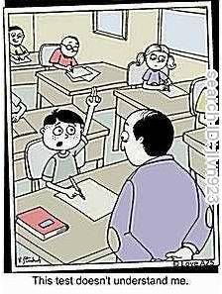
Reasoning
She works hard in class and understands the material, too. But she regularly does badly on tests
She often helped Jessie in class – he often doesn’t understand maths, but he’s good at tests.
The teacher always gives grades for test scores and not for anything else.

Slide 22
She glanced over Jessie’s shoulder just long enough to get the final answer to the question. Then, she figured out the rest of the problem on her own.
Google ‘ethical dilemmas for students’ for more ...

Slide 23
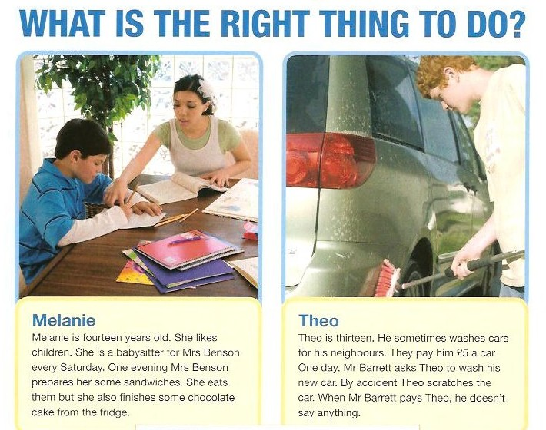

Slide 24
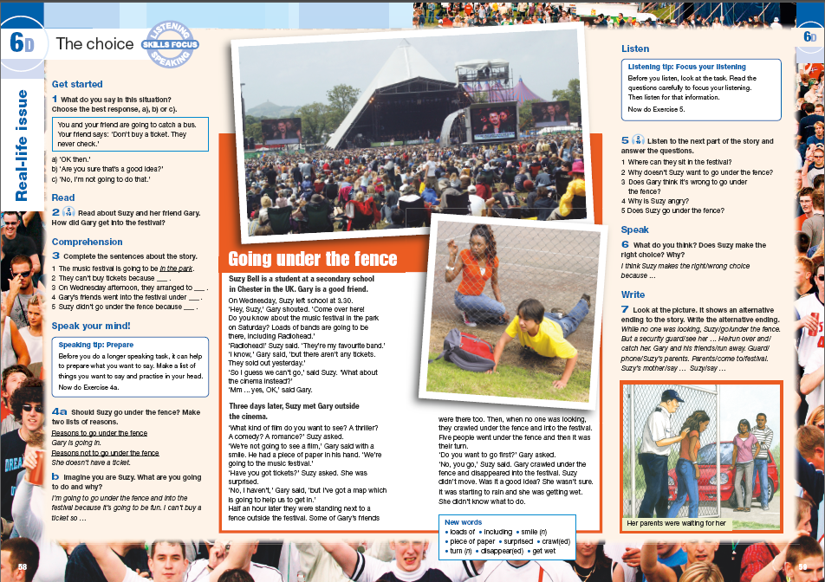

Slide 25
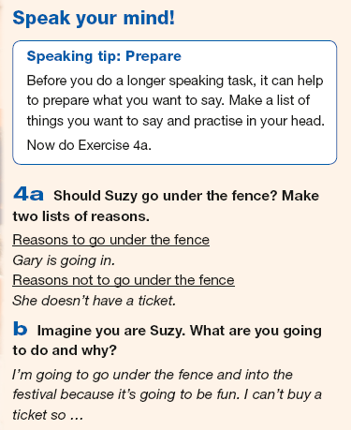
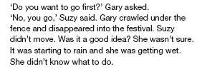

Slide 26
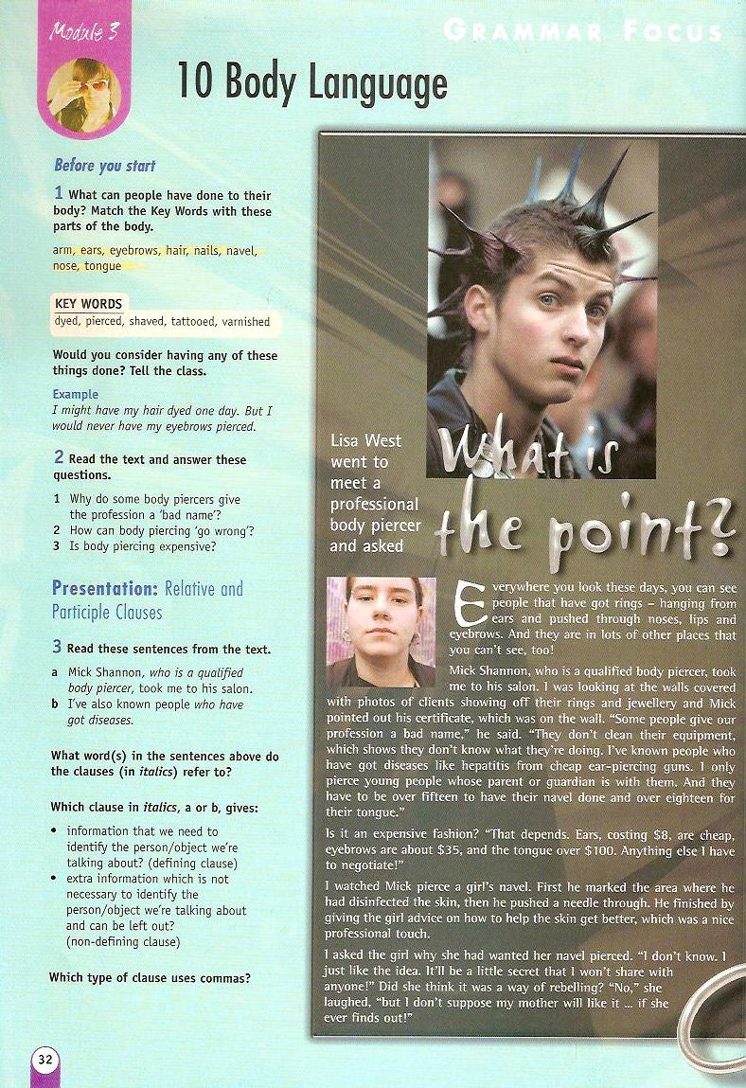

Slide 27
Cognitive skills
Memory – storage and recall
Simple mathematical- logical reasoning
Visual perception
etc, etc, etc....

Slide 28
Vocabulary Storage Techniques
Word Webs
Categorising
Geography words
Vegetables
Meat
Land mountain forest hill desert | Water river sea ocean lake
FOOD
Fruit
Snacks
apple
pear
orange

Slide 29
Memory
Recall

Slide 30
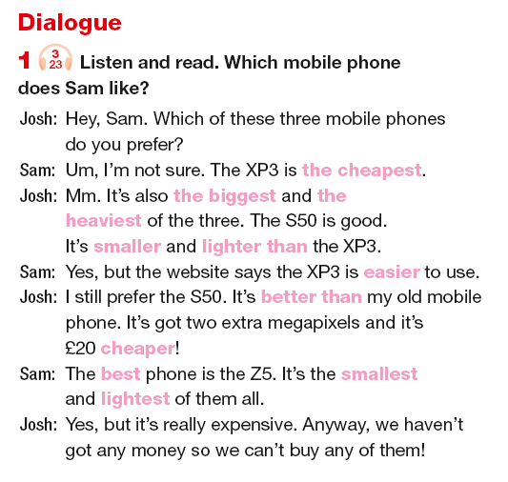
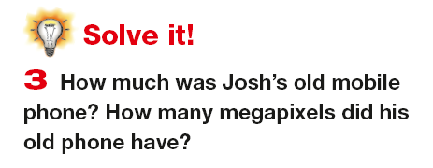
Maths

Slide 31
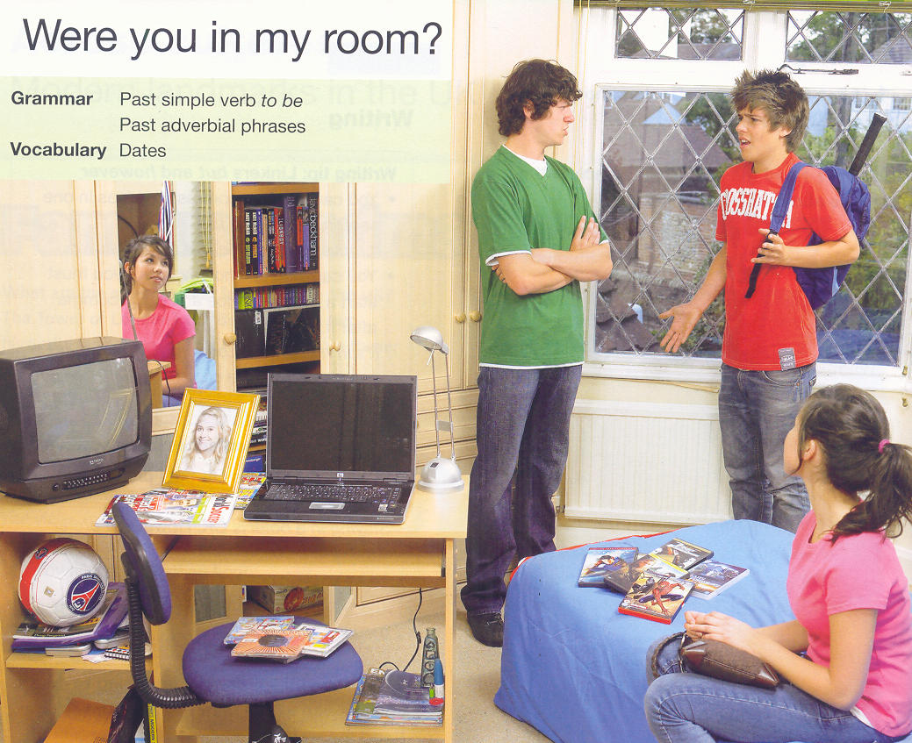
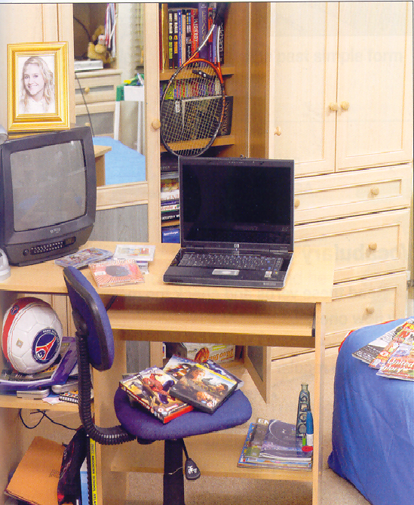
Visual perception

Slide 32
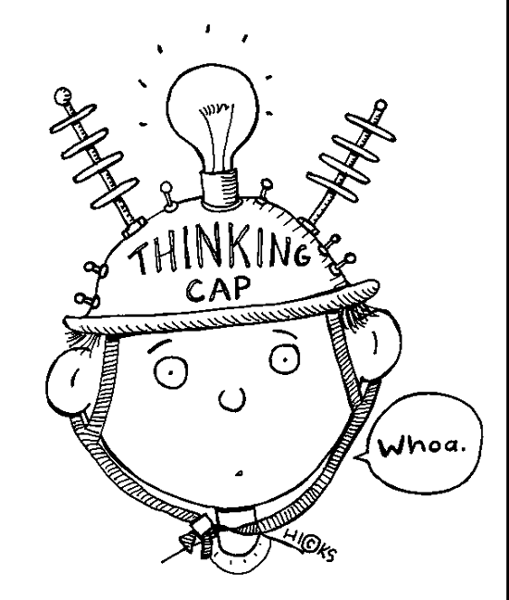
Metacognition
Metacognition is awareness and understanding of one's own thought processes and includes:
Identifying and analysing a task
Planning steps to achieve the task
Reflection on task achievement
Monitoring progress
This helps students to understand their strengths and weaknesses.

Slide 33
Questions to ask
“How can I do this task? How long will it take?”
“What have I done before that’s similar?”
“ How did I do this task?”
“Where did I find the answer?”
“ Why is the answer right/wrong?”
“What is usually easy/difficult for me?”
“What do I need to practise more?”
“What am I good at?”
“What can I achieve by the end of term if I spend 1 hour a day studying outside class?”

Slide 34
Metacognition starts at an early age!

Slide 35
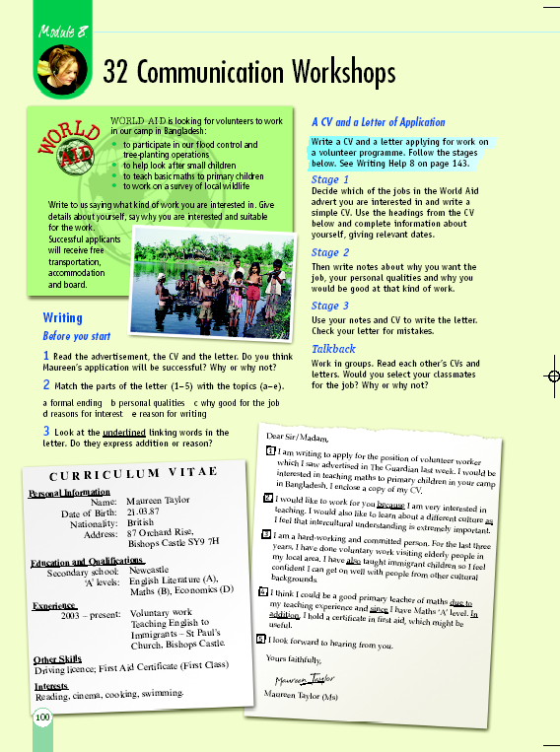
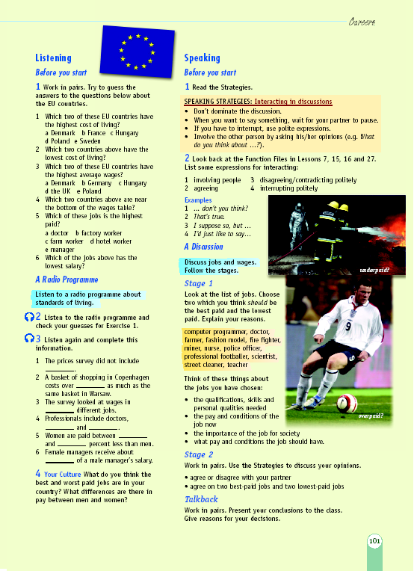
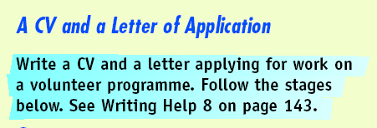
Prepare students for work
Notes:
M: It will also give us the chance to have more communication workshops (SLIDE 24) and therefore more project work (SLIDE 24A). Teenagers would then be able to create things that particularly interest them.

Slide 36
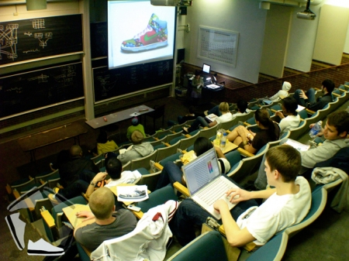
Prepare students for higher education
Organisation
Time management
Autonomy - self-directed study and self-discipline
Personal responsibility for progression in learning
Accessing support
Academic reading - critical appraisal of sources (Wikipedia!)
Creative and critical thinking
Groupwork – contribute and work as part of a team
Public speaking - give presentations
Research skills
Academic writing

Slide 37
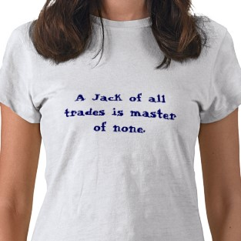
Teachers today
Rather, we must be Master of all trades and Jack of none

Slide 38
Judy Copage
judy.copage@pearson.com

